Slide 1
CS 419: Production Rendering Procedural Textures
Eric Shaffer

Slide 2
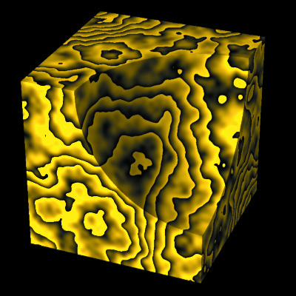
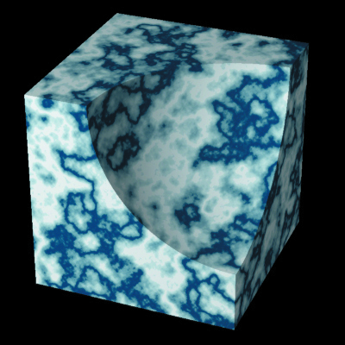
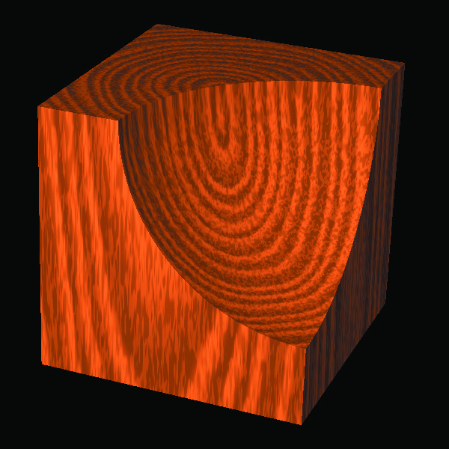
Procedural Textures
Procedural texturing generates a texture algorithmically
As opposed to storing one as data and doing lookups
Procedural modeling is similar in that it generates gometry

Slide 3
Procedural Textures
Popularized by Peachey and Perlin (1985)
Perlin won an Oscar in 1997 for his work on procedural textures
Advantages
Compact…not much storage required
No aliasing…they are not fixed resolution
Single procedural texture can generate several different effects
You simply change input parameters
Disadvantages
Higher computational cost than texture mapping
Can be difficult to develop and implement

Slide 4
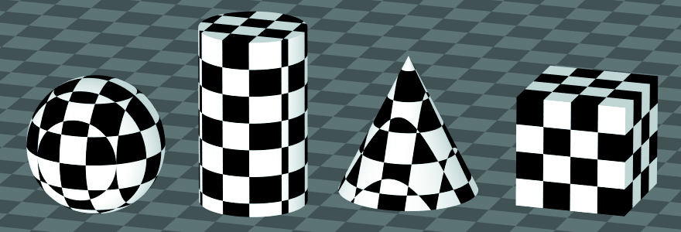
3D Checker Texture
Iconic procedural texture in computer graphics
…it often nicely demonstrates aliasing
How could we implement it?
Imagine filling the world with cubes of alternating white/black

Slide 5
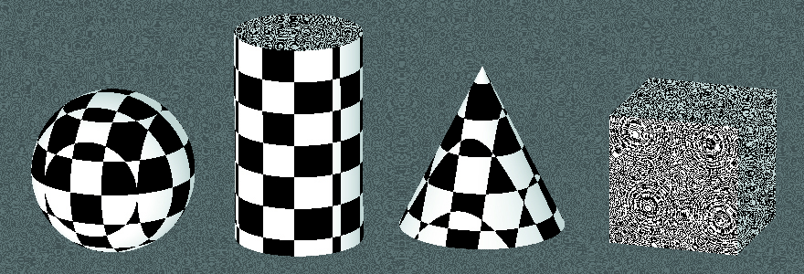
3D Checker Texture
So what went wrong?
How would you fix it?

Slide 6
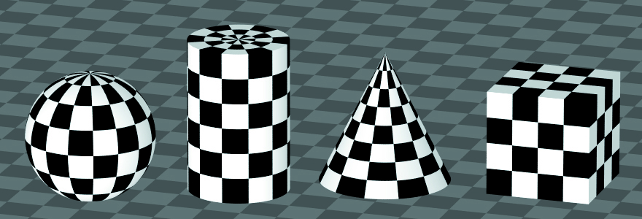
2D Checker Texture
For the best results, need geometry-specific procedural textures

Slide 7
2D Planar Checker Texture
To make it more exciting we can optionally render a 2D grid

Slide 8
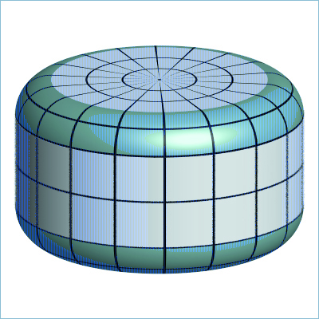
2D Planar Checker Texture

Slide 9
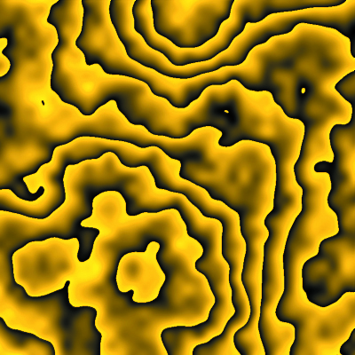
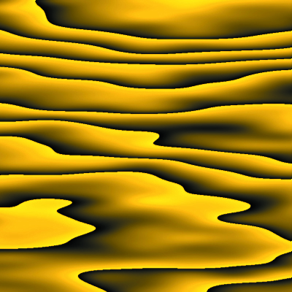
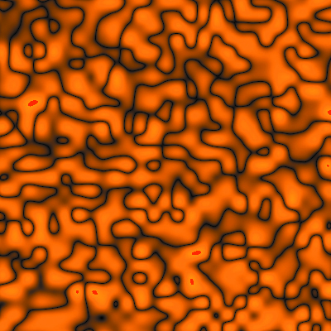
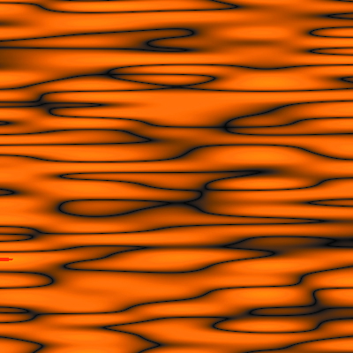
Texture and Transformations
Examples of non-uniform scaling of textures

Slide 10
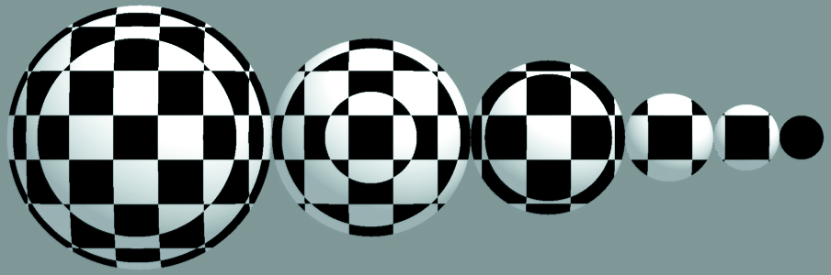
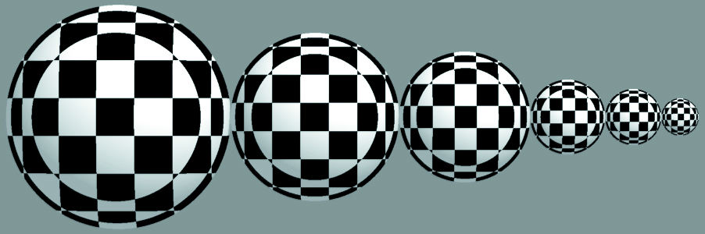
Scaling Textures
Texture not scaled
…and scaled so that the size of the checkers relative to the sphere stays the same

Slide 11
Transforming Textures
To transform the texture, inverse transform the hit-point
…using the inverse of the object transformation

Slide 12
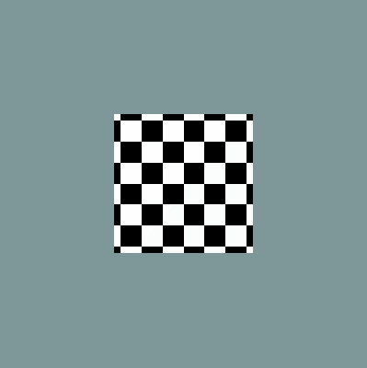



Transforming Textures
Inverse transformation technique will work for any arbitrary set of affine transformations
What would it look like if we animated a textured object without transforming the texture?

Slide 13
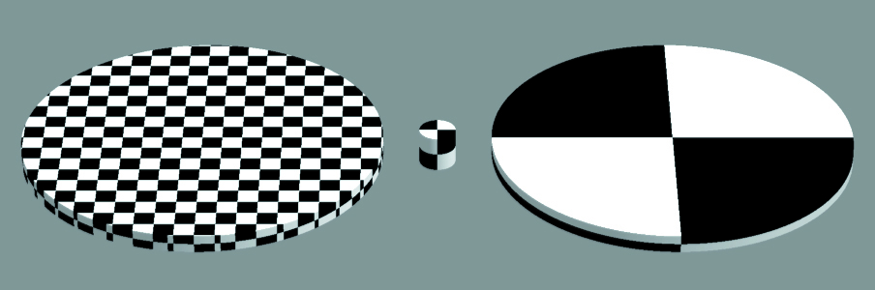
Transforming Textures

Slide 14
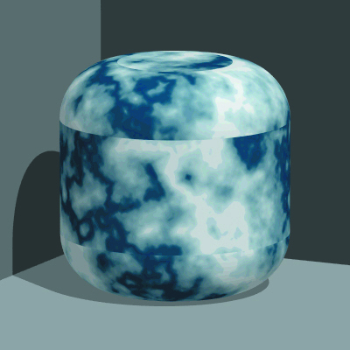
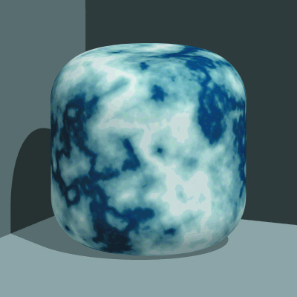
Example of a Noise-based Texture

